Slide 1
Women Coming of Age in Classics vs. Fanfictions
Distributed Computing Project I
Deniz Kardes-Birinci | Mileva Van Tuyl | Marina Sánchez | Melanie McCord
April 2022

Slide 2
Overview
How has language and the representation of women changed between classic novels and modern fanfiction?
What roles and traits are associated with women across the different texts?
What emotions and sentiments are expressed when portraying women in the texts?
1. Processing
2. Topic Analysis
3. Sentiment Analysis
4. Summary
Data Collection and Preprocessing Pipeline
Topic Modeling and TF-IDF Analysis
Emotion and Analysis of Sexism and Racism
Conclusions and Next Steps

Slide 3
Texts: Classics and Fanfiction
CLASSIC TEXTS
1. Jane Eyre
2. The Secret Garden
3. Anne of Green Gables
4. Wuthering Heights
5. The Governess; Or, The Little Female Academy
6. Pride and Prejudice
7. Middlemarch
8. Little Women
FANFICTION TEXTS
1. First Impressions: A Modern Pride and Prejudice Adaptation
2. An Ever-Fixed Mark
3. Amy's Progress Vlogs
4. Outnumbered
5. Hermione Granger and the Perfectly Reasonable Explanation
6. Manager
7. Scarlet Justice
8. The Bug Collector
9. Tension Points

Slide 4
Text Preprocessing
Get raw texts in .txt files
Read corpus in two Pandas dataframes: Classics and Fanfictions
Convert Pandas dataframes into PySpark SQL dataframes
Generate Spark NLP preprocessing pipeline
DocumentAssembler
Tokenizer
Normalizer
StopWordsCleaner
LemmatizerModel
Apply Pipeline to raw Classic and Fanfiction texts
Output: List of cleaned tokens for each book

Slide 5
LDA Topic Modeling
Topics that characterize fanfiction vs female coming of age
How does it change based on fanfiction vs coming of age?

Slide 6
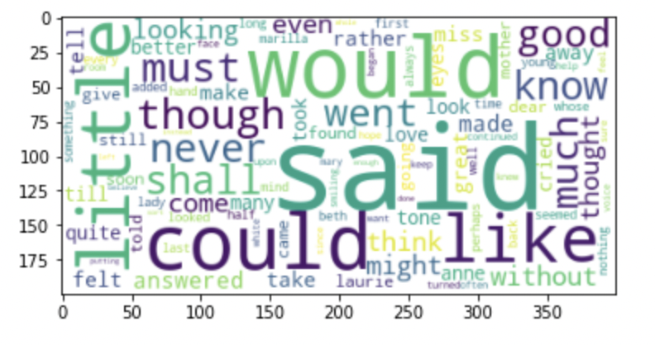
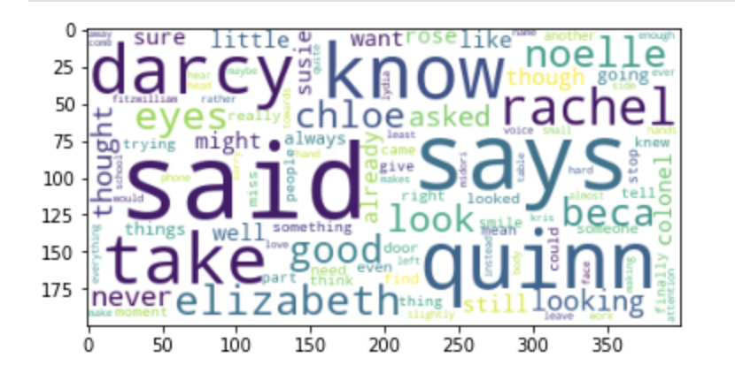
LDA on Lines
Weights of topics correspond to their term weights.
Classics, Fanfic

Slide 7
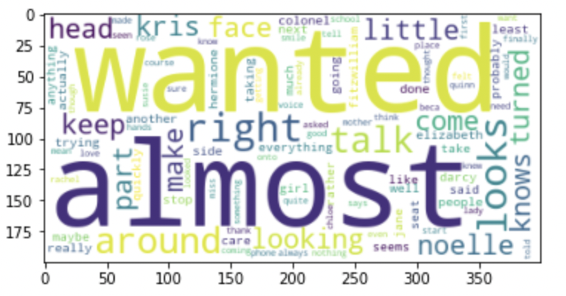
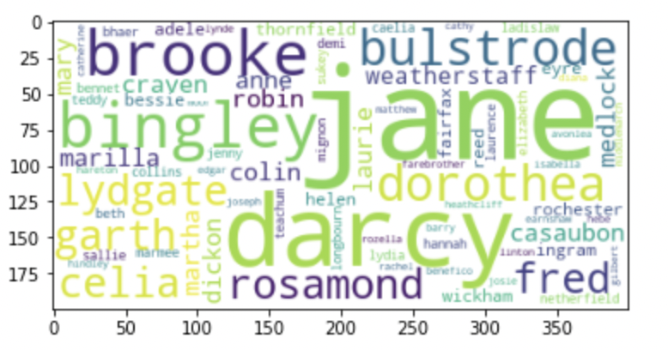
LDA on Books
Weights of topics correspond to their counts.
FanFic, Classics
Size corresponds to counts

Slide 8
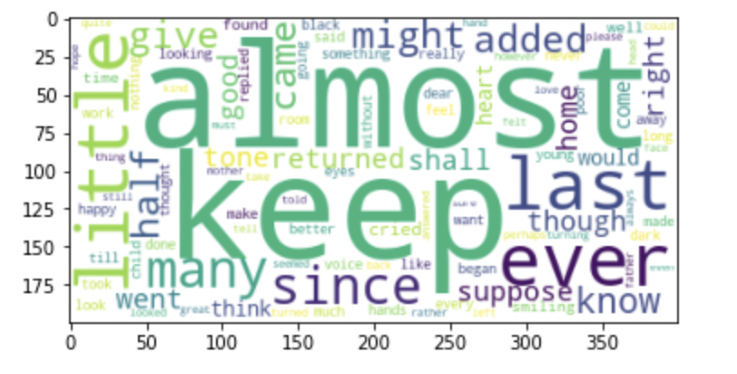
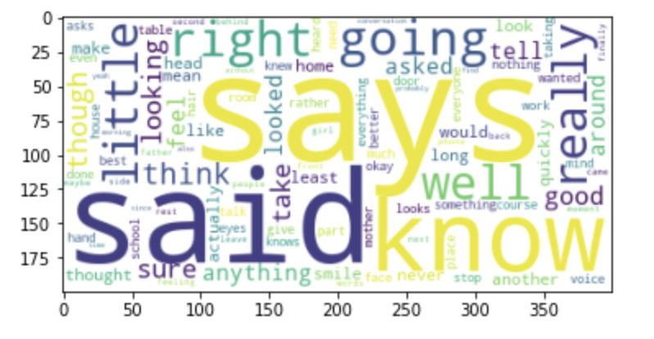
LDA on Removing Proper Nouns
Weights correspond to their counts.
Classics, FanFic
Size corresponds to counts

Slide 9

TF-IDF Word Importance
Term Frequency — Inverse Document Frequency
A metric to assess a word’s importance and significance within a collection of text
Notes:
$$ \text{TF-IDF}(word) = t_f * \text{log}(\frac{\text{Total Number of Documents}}{\text{Number of Documents Containing Word } word})$$

Slide 10
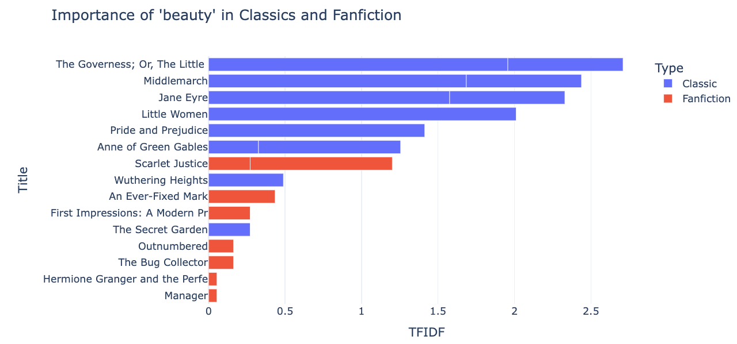
Notes:
What is valued? Beauty? Ambition?

Slide 11
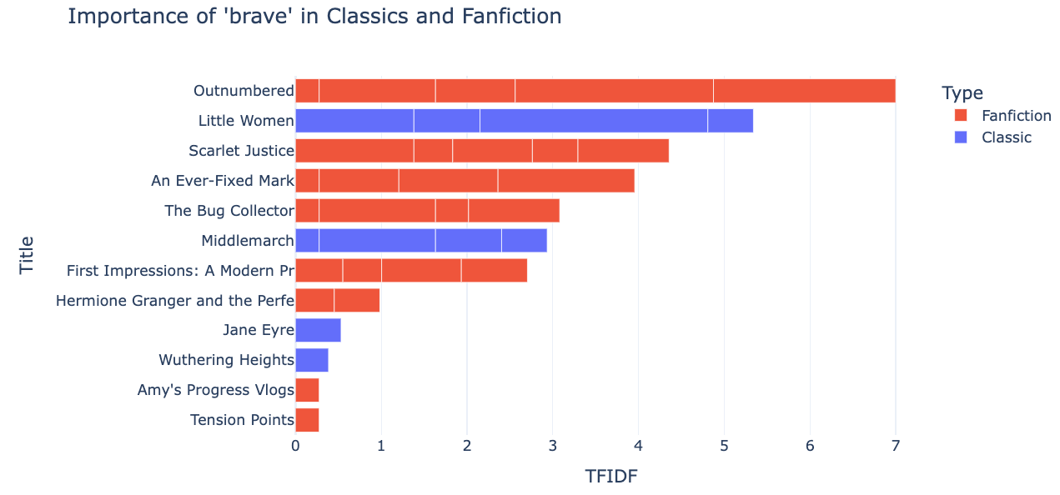
Notes:
Women’s character traits

Slide 12
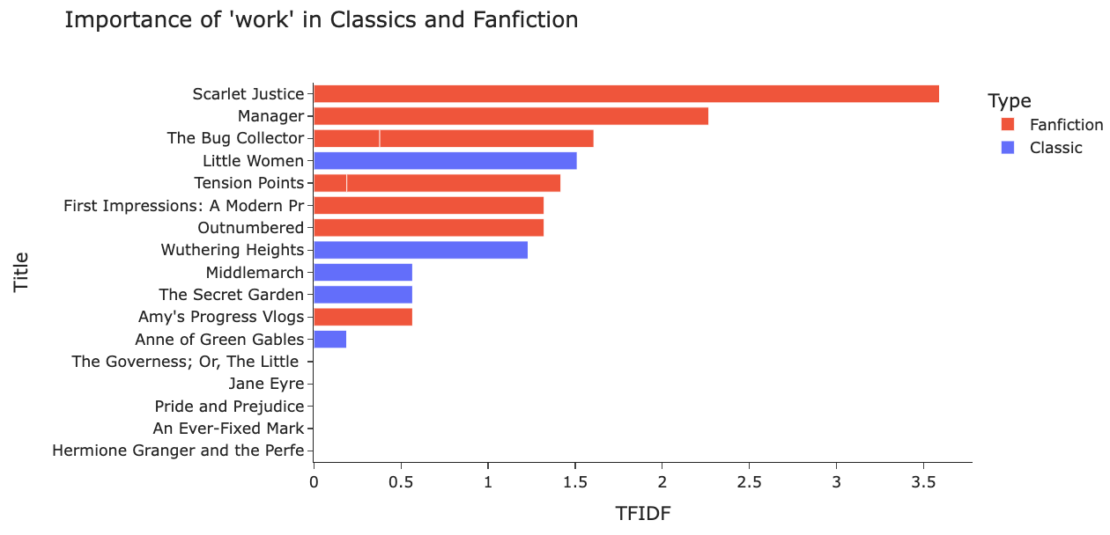
Notes:
Women’s role

Slide 13
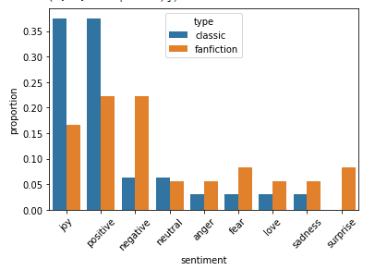
Sentiment Analysis
Four Spark NLP pre-trained models
Predominant sentiment in each corpus
Average between the four models
Compare Classics vs. Fanfictions
Positive sentiment predominates in Classics
Negative sentiment is more present in Fanfictions
Fanfictions present a wider range of sentiments

Slide 14
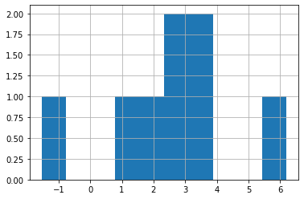
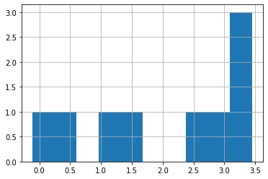
Afinn Score: Classics vs Fanfiction
Notes:
We also wanted to go in details for the tone of the books. We used Afinn score to measure how positive or negative each word in the each book. Afinn score ranges from -5 to 5. For example, I am having good day scores +3, I am having bad day scores -3. Or I am having a horribly bad day scores -6. In here, we standardized the afinn scores by finding the score for each word in the text, adding the scores up and dividing by number of words in the context. In the distribution of classics, we can observe that it ranges from -1 to 6 while the distribution of fanfiction ranges from 0 to 3.5. As verification of what we observed in the spark nlp classification, the mean score for classics is greater than the mean score for fanfictions.

Slide 15

Sentiment Analysis
Discrimination
Racist? Sexist? Neutral?
Hate speech? Offensive? Normal?
Antisemitic? Non-antisemitic?
3 pre-trained Spark NLP models

Slide 16



Conclusions
Representation of women differs from classic novels and modern fanfictions
Extend analysis by expanding the sample size, genre, and variety of texts
Isolate segments of the text that focus on the female protagonist for further analysis

